Slide 1
What is a nurse?

Slide 2
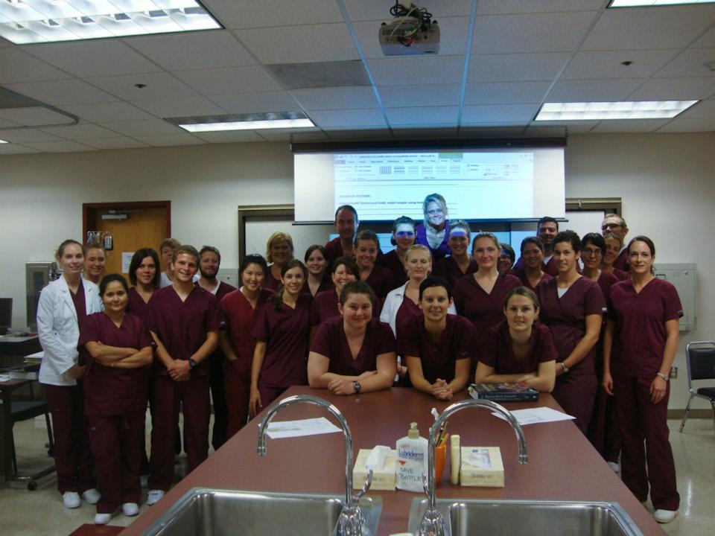
Nurse trivia game
Question 1:
How many years does a Registered nurse have to go to school?
Notes:
How many years does an Registered nurse have to go to school?
20 years
4 years
½ year
All their life
What is the uniform that nurses wear called?
Scrubs
Places Nurses work?
-school
-camp
-Hospital
-Doctors office
-helicopters
-peoples homes
-military
-cruise ships
What kinds of things do nurses do at work?
-give shots
-help with surgeries
-help deliver babies
-wipe bums
-give CPR
-brush teeth
-help people heal
-encourage healthy eating
-educate people on how to not get diseases (educate on how to NOT spread colds (wash hands, sneeze into elbow, don’t share drinks)
-hold peoples hands when they are in pain
-care for peoples wounds
-Fly in planes and helicopters
-go to war!
-care of people at the end of their life

Slide 3
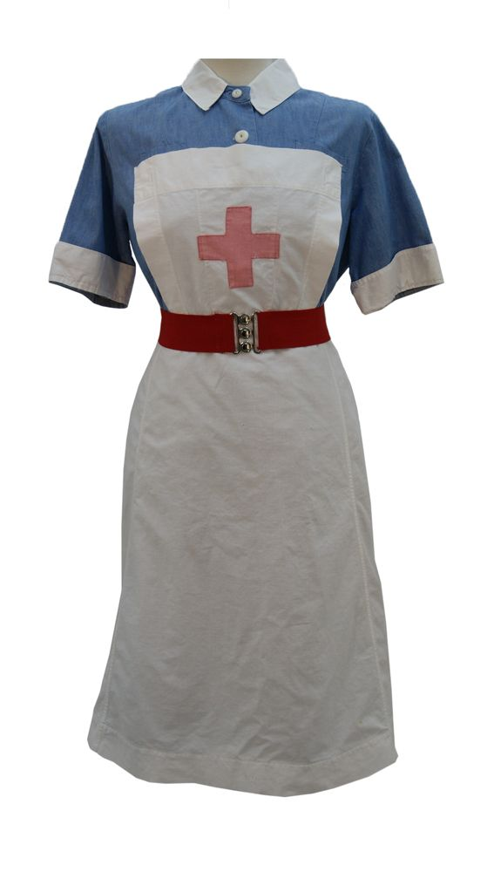
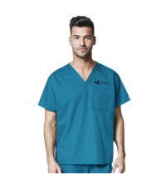
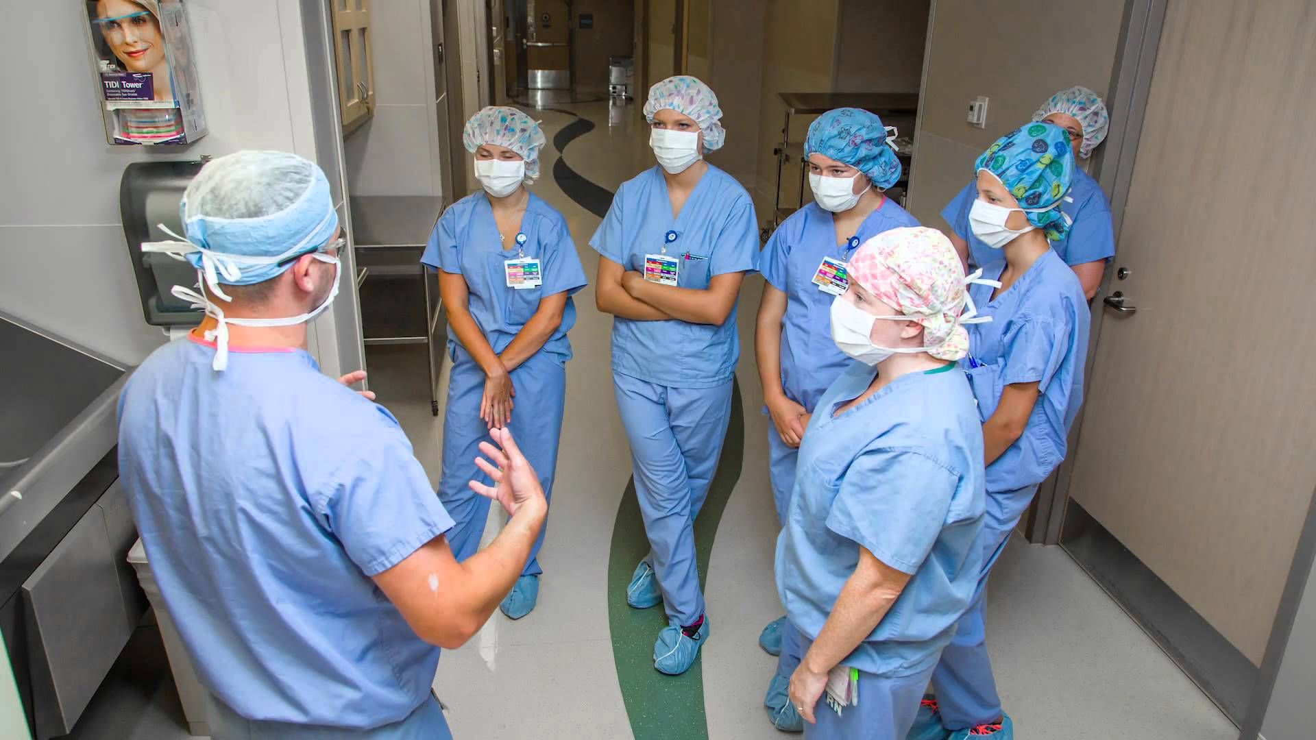
Question 2:
What is the uniform that nurses wear called?

Slide 4
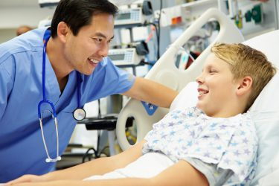
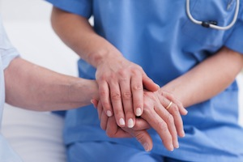
Question 3:
True or false: nurses are caring, kind and compassionate.

Slide 5
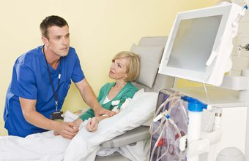
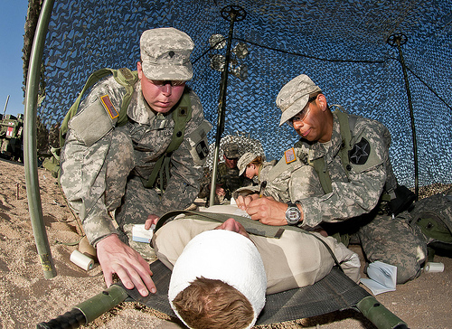
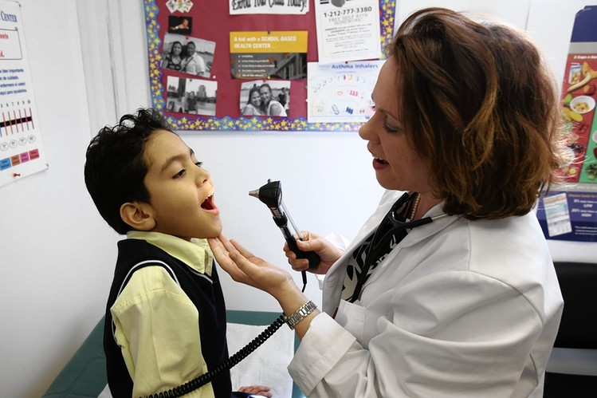
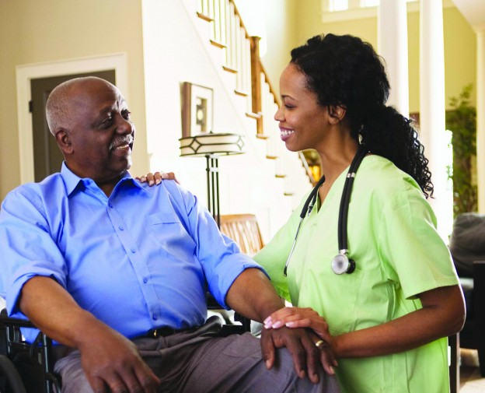
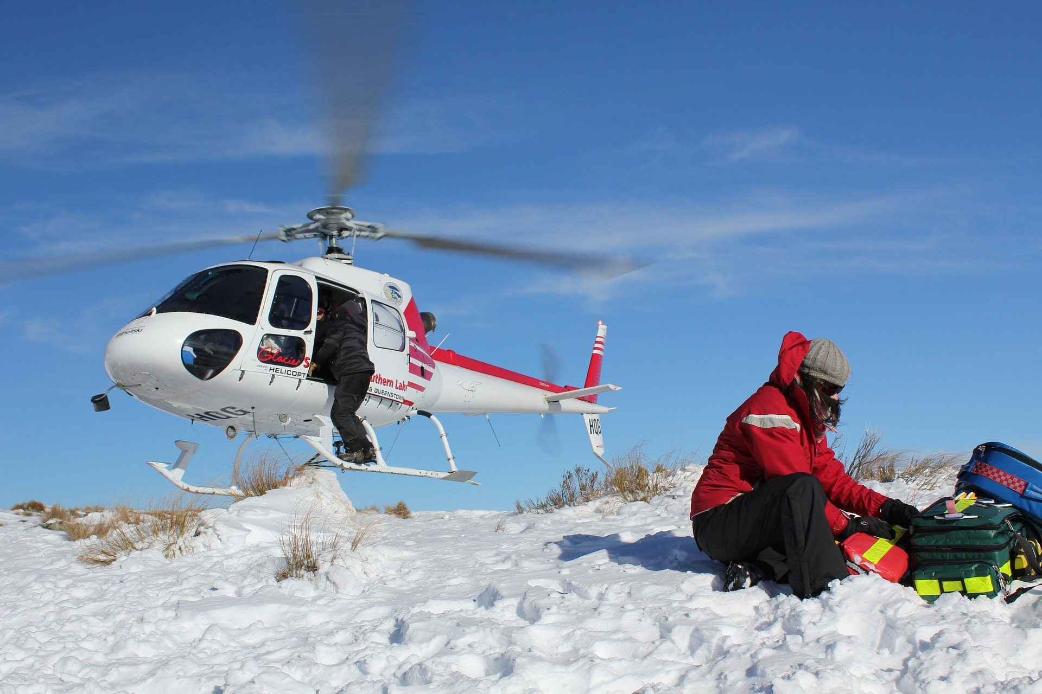
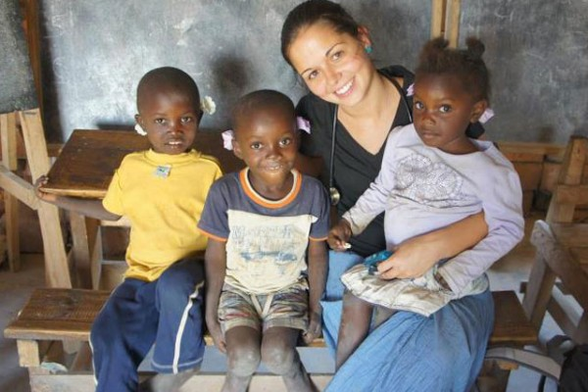
Question 4:
What types of Places do nurses work in?

Slide 6
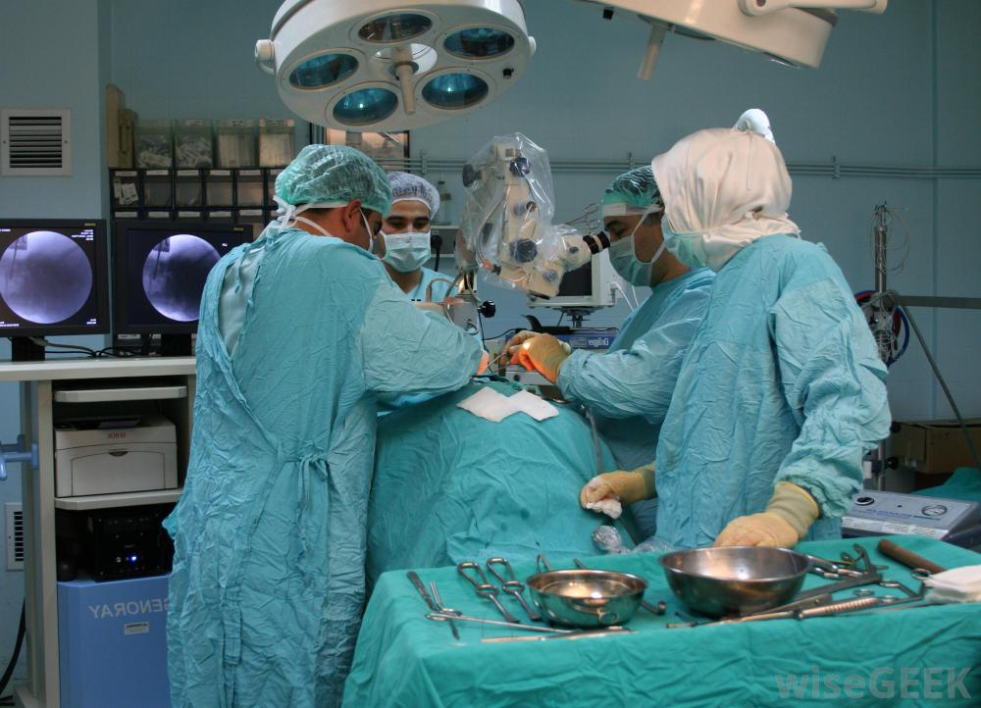
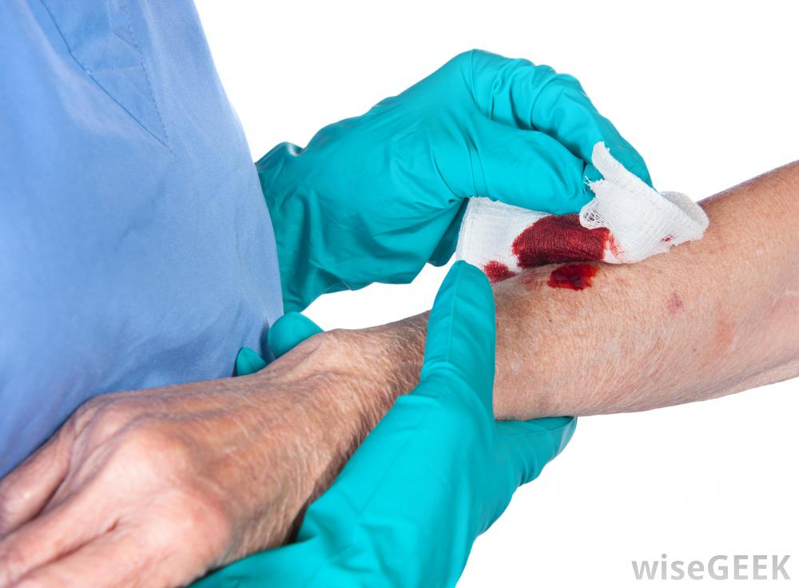
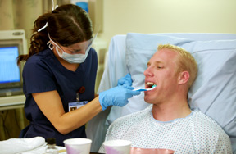
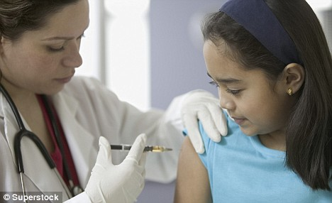
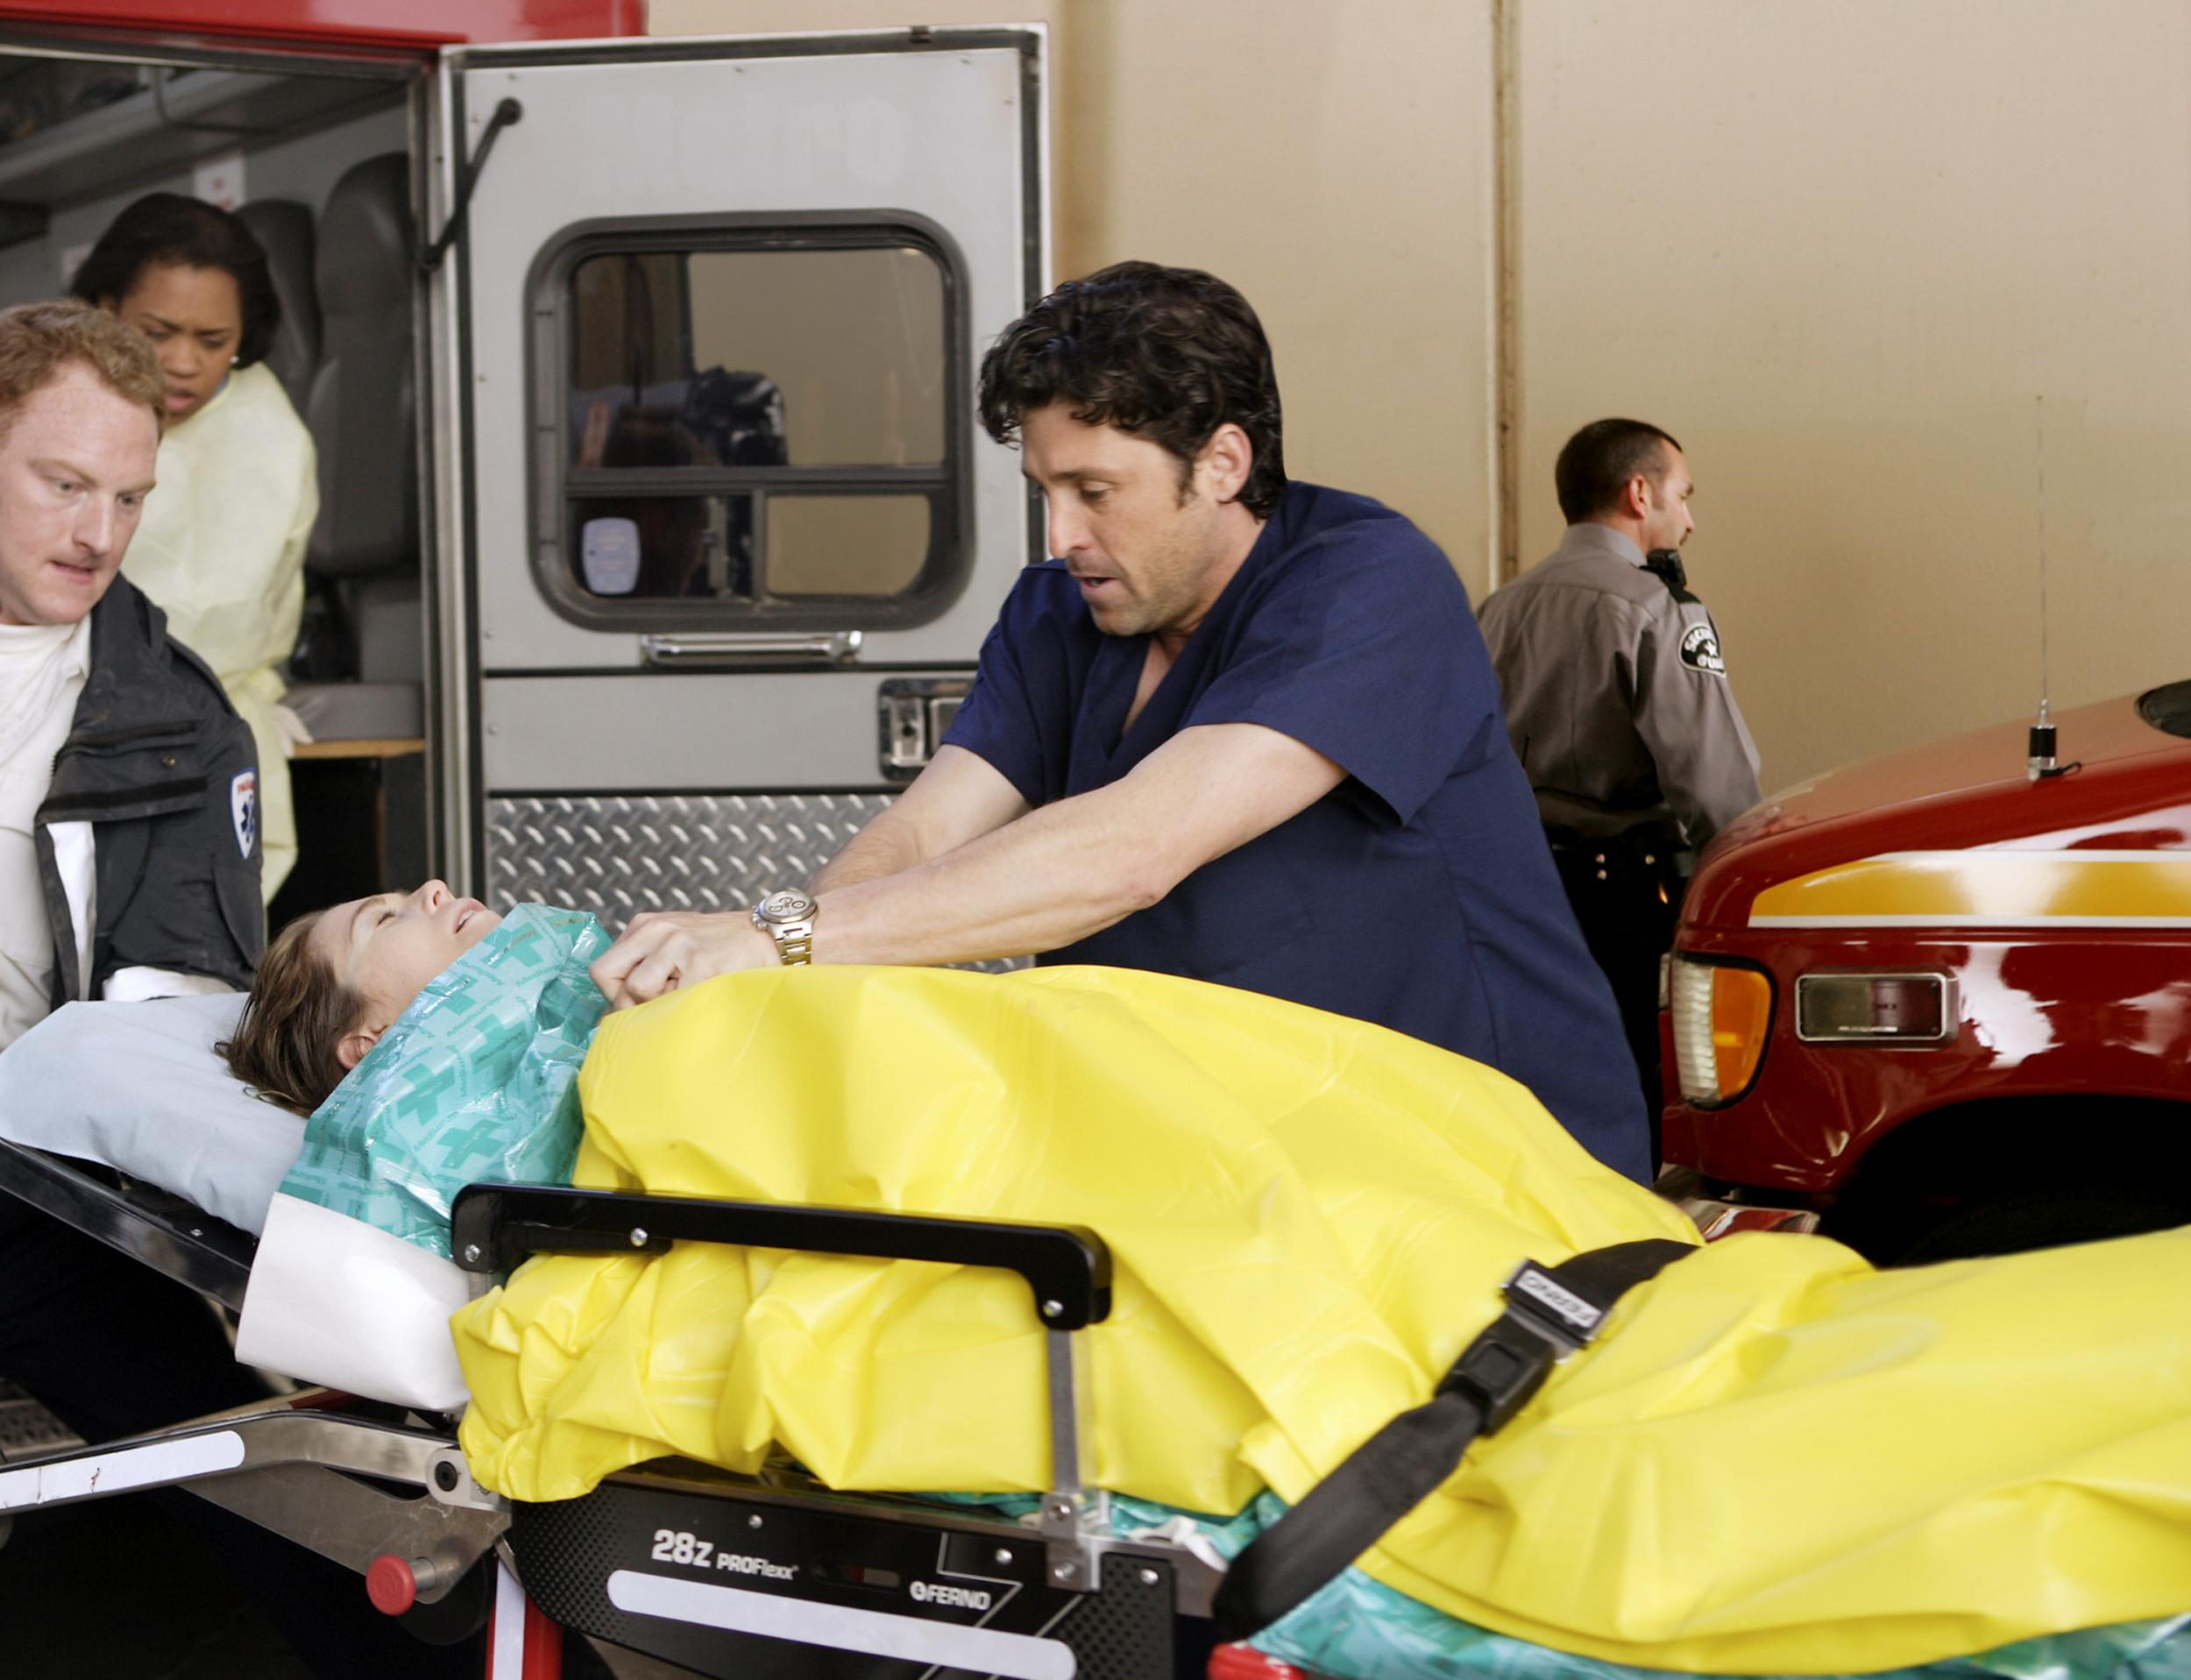
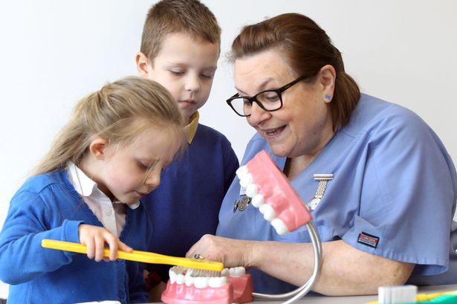
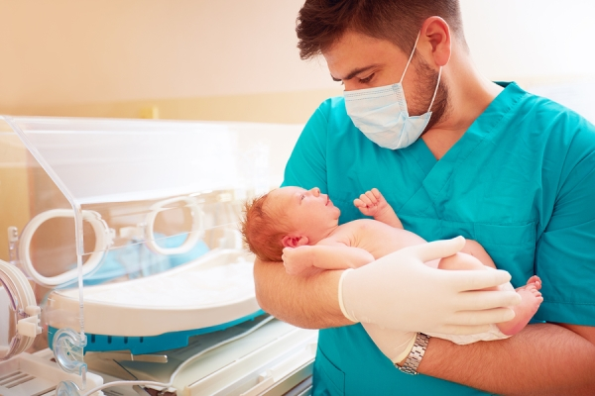
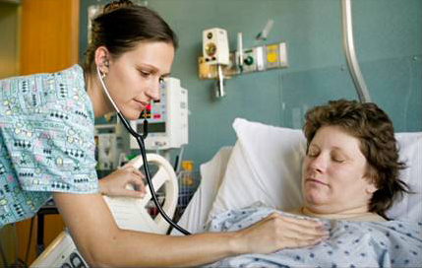
Question 5:
What kinds of things do nurses do at work?

Slide 7
Fun facts about nursing
Boys and Girls can be nurses! Who do you know that is a male nurse?
On average in one hour nurses make $32.00 !! WOW!!
$1,280 /week
$5,120 / month
$62,000 / year
Florence Nightingale was the worlds first nurse (handwashing)
Nurses are always on their feet helping others. (4-5 miles/day)
Out of all the jobs in the world, people trust nurses the most

Slide 9
Any questions??

Slide 10
Who needs a bandaid?

