Slide 1
Becoming A Chef
By: Charity Caldwell

Slide 2
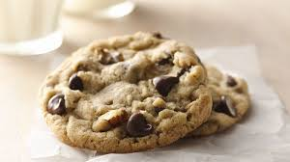
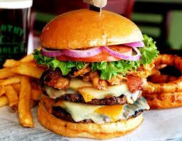
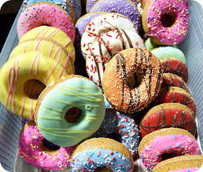
Food we love
Notes:
Why Do we always love the things that arethe most unhealty for us?

Slide 3
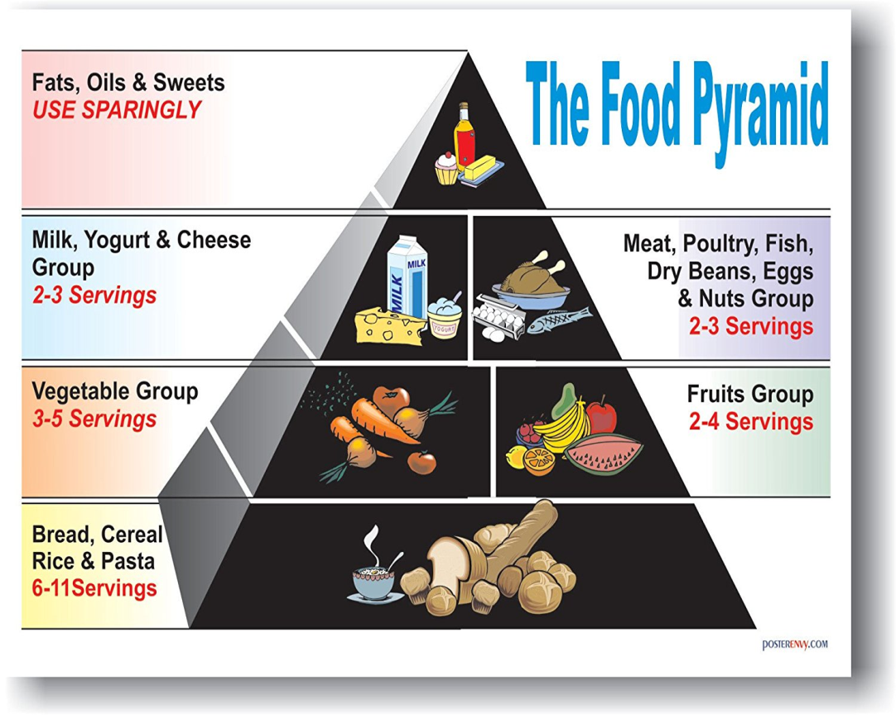
Foods we should eat
Notes:
Everything in moderation
Homemade vs. Store bought

Slide 4
Take off my skin and I won’t cry, but you will. What Am I?

Slide 5
Why should people know how to cook?
To eat and live
Guys can impress girls
Girls can get ready for their future husband
So you can eat healthy
You can cook whatever you want, and eat it
So you know what goes into your food
Because its fun experimenting
Everyone's best friend is a cook

Slide 6
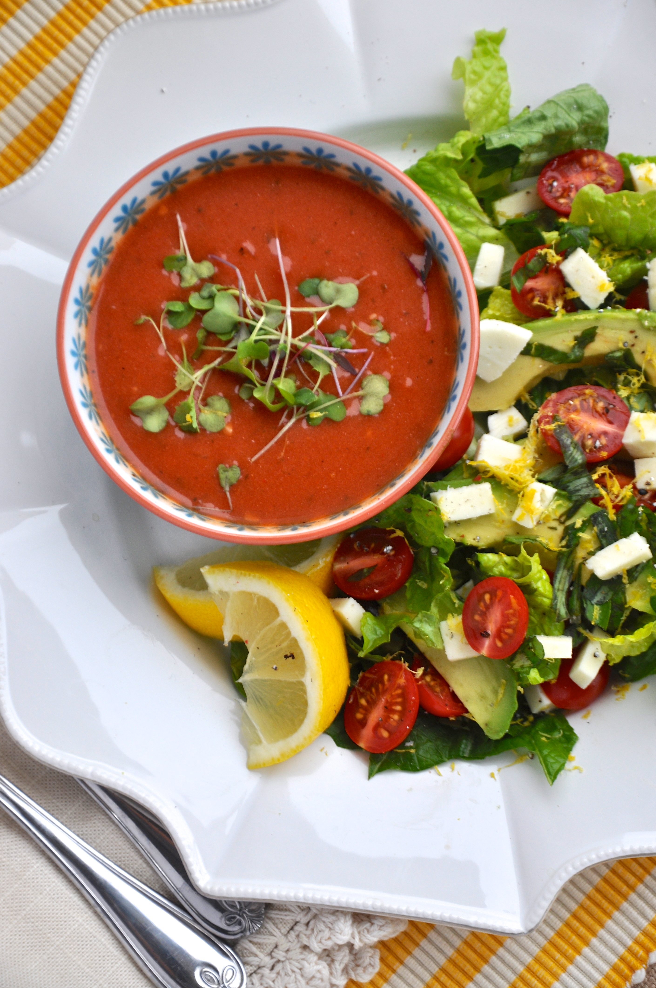
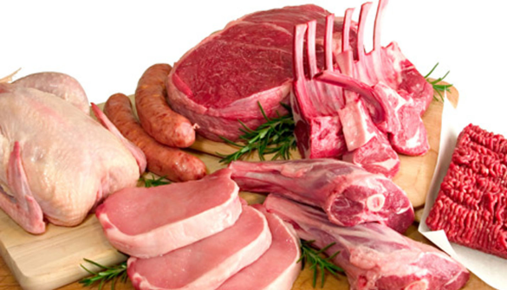
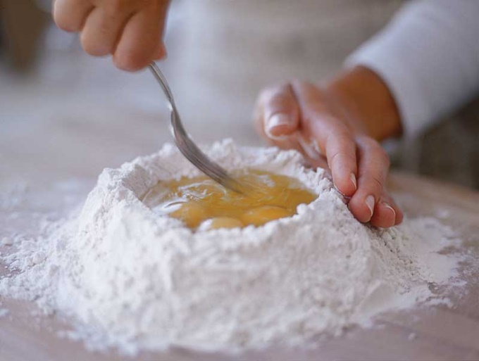
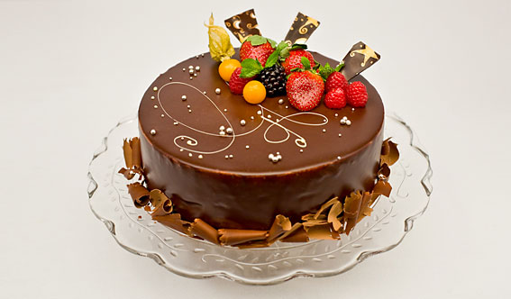
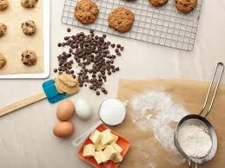
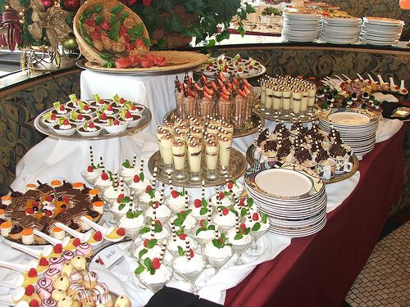
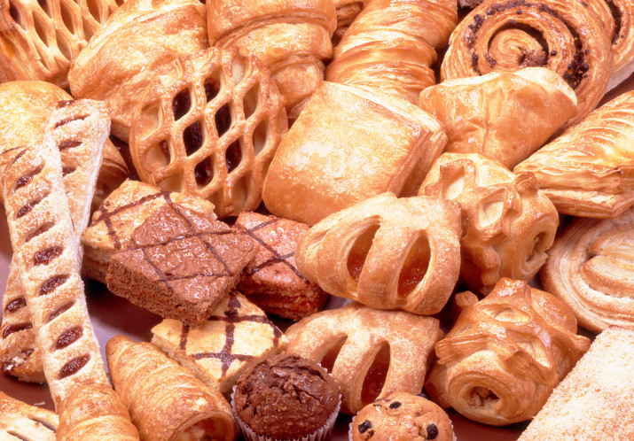
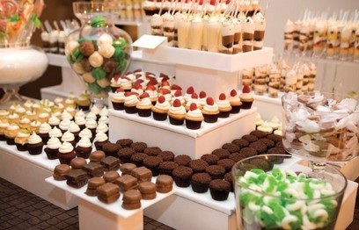
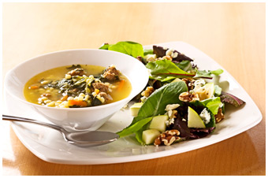
What is the difference
Cook
Baker
Focus on things like
Equipment used- very sharp knives, meat slicers, grinders, grills, and ovens
Skills used in cooking are… slicing, dicing, frying, boiling, seasoning, grilling, steaming and more
Focus on things like
Equipment used- blenders, mixers ,and ovens
Skills used in baking are… kneading, rolling ,cutting shaping dough
Notes:
Bakers are primarily concerned with baking breads, cookies, cakes, cupcakes and other baked goods. Flour is the main ingredient of their craft and is the foundation of all the delectable products that are sold in groceries, bakeshops and restaurants. They can either work as commercial bakers where they produce large volumes of baked goods following standard recipes or as retail bakers where they make fewer quantities of baked products and have the freedom to experiment with new recipes.
They know how to create delicious treats from meat, seafood, vegetables, grains, fruits and nuts, among others. They can make appetizers, salads, soups and main courses. They may also specialize in the dishes from different parts of the world that are known for their gastronomic delights such as Italian, Mediterranean and Asian cuisines. Chefs mostly work in restaurants and eating establishments which some of them own although they may also be hired by hotels and other traveler accommodations and special food services firms.

Slide 7
What are chefs good at?
Making tasty food
Chopping veggies really fast
Working long hours for little pay
Making people happy
Helping people live
Multi-tasking
Working fast
Getting up early
Having fun in the kitchen
Washing dishes
Cleaning up ALL the time
Notes:
Find a video of chopping real fast

Slide 8
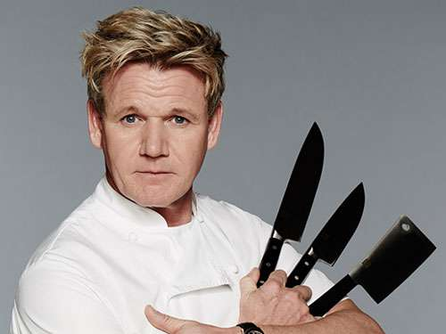
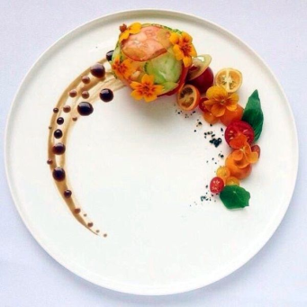
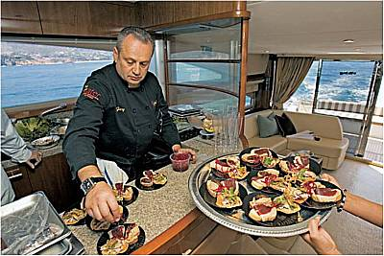
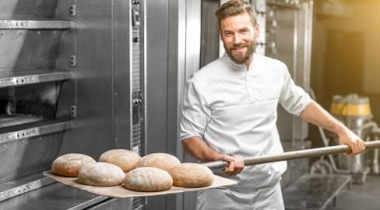
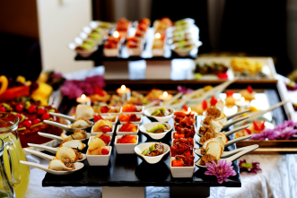
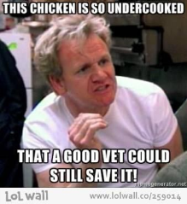
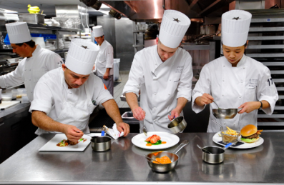
If you go to culinary school
You can become a…
Chef
Baker
Food Artist
Food Critic
Private Chef on a Boat or Plane
Work in a Hotel
Have Your Own Catering Business

Slide 9
My journey as a cook
Started when I was 3 in the kitchen with my mom
High school cooking classes
Culinary arts in college
Cooking Competion
Working at Ciao Thyme
Teaching cooking classes
Catering weddings and events
Cooking fancy dinners
Being a baker
My future plans

Slide 10
Any Questions?

